Slide 1
Warm-ups
DSD 2020-1-1
Rui ZHANG
Official Language: English

Slide 2
Contents
Introduction to DSD
Basics
Project Description
Teams & Roles

Slide 3
Introduction to DSD
Intro_to_DSD

Slide 4
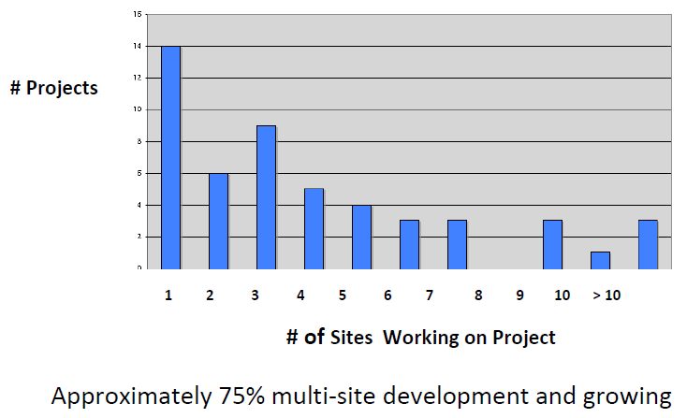
Growth of DSD
Increasingly used by companies of all but the smallest size, with an outsourcing growth by an order of magnitude over past few years
Over half of the Fortune 500 companies
Software industry: Google, Microsoft, IBM, Tencent, Huawei, etc.
Other industry: telecom, device producer, IoT, etc.
If you work in industry, you will most probably
work in a distributed team.
Sample of Development of 52 Major Projects at Avaya Corp. 2006

Slide 5
Why?
Answer from Industry
Expanded pool of trained workforce
Necessity of getting closer to customers and using locality specific expertise to customize/localize products
National policy in some countries where the government may be a customer requiring suppliers to locate R&D facility in that country as a condition of sale or a favorable tax treatment
Difference in development costs
Promise of round-the-clock development that could lead to shorter intervals

Slide 6
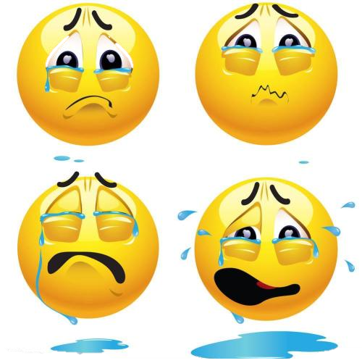
Why not?
Increasing risks compared to similar co-located developments
Schedule delays – same work takes longer
Higher risk of failure
Reduced product capabilities
Decreased functionality, qualities
Doesn’t meet some customer requirements
Increased cost
May cost more in spite of lower labor costs
Schedule delays and rework increase costs

Slide 7

Difficulties
Nature of a software project: dependencies
tasks (requirement → design → coding)
people (interactions among different roles)
Successful development requires effective coordination between people and tasks!
work (need product A to produce product B)
schedule (must finish A before starting B)
people (person P has expertise need to produce A but is busy)
Coordinate over distance

Slide 8
Why Difficult in Contrast to …
In co-located projects, people build up ways of coordinating work
Common Understanding
Shared view/stand (implicit or explicit) on …
People (roles, expertise, responsibilities)
Tasks (dependencies)
Same language, vocabulary, culture, backgrounds
Free flow of information through informal channels
Walk-in face to face contact
Progress meetings (arguments)

Slide 9
Open Question
答案解析
Points: 2
Remark
What do you imagine the DSD look like?
Please answer in item list of keywords, better with explanations.
For example:
Time difference
…
– Less effective communication
• Temporal distance
• Socio-cultural distance
• Spontaneous communication declines rapidly with distance
• Fewer overlapping work hours
• Low bandwidth links (e.g., email and other asynchronous)
• 2.5 times as long to communicate compared to co-located
– Lack of awareness
• Lack context hence knowledge of history, relationships
• What people are doing day to day, concerns, availability
– Incompatibilities
• Differ in tools, processes, work products Leads to confusion, misunderstandings, inconsistencies
正常使用主观题需2.0以上版本雨课堂
作答
可为此题添加文本、图片、公式等解析，且需将内容全部放在本区域内。正常使用需3.0以上版本

Slide 10
Especially in Software Development
Manifests as difficult problems in coordination and control of software development
To establish requirements (eliciting, understanding, negotiating)
To effectively distribute work
To detect and correct conflicting assumptions
To detect and correct slips in schedule
To manage change (especially requirements)
To manage development resources (schedule, personnel, budget)
Similar to traditional SE problems, but more difficult
Work takes longer
Inter-site changes may take 2.5 times as long as intra-site changes
(See Herbsleb, Mockus; An Empirical Study of Speed and Communication in Globally Distributed Software Development)
Requires more effort

Slide 11
Risks
Building the correct software (behavior or qualities)
Fully understand (or misunderstand) the requirements
Developers build the wrong thing
Inadequate verification, validation
To decompose the work into assignments that together address behavioral and developmental goals
To ensure each team builds what is needed by the others (interaction, group play)
Project management(budget, schedule, personnel)
Balancing workload, skills across sites to meet developmental and quality goals
Developing common understanding of who should be developing what in which timeframe
We will examine the risks in detail as we develop projects (not only here in DSD)
Fundamental issue is how to mitigate DSD risks

Slide 12
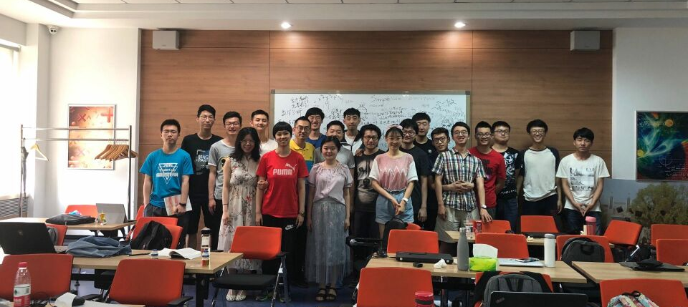
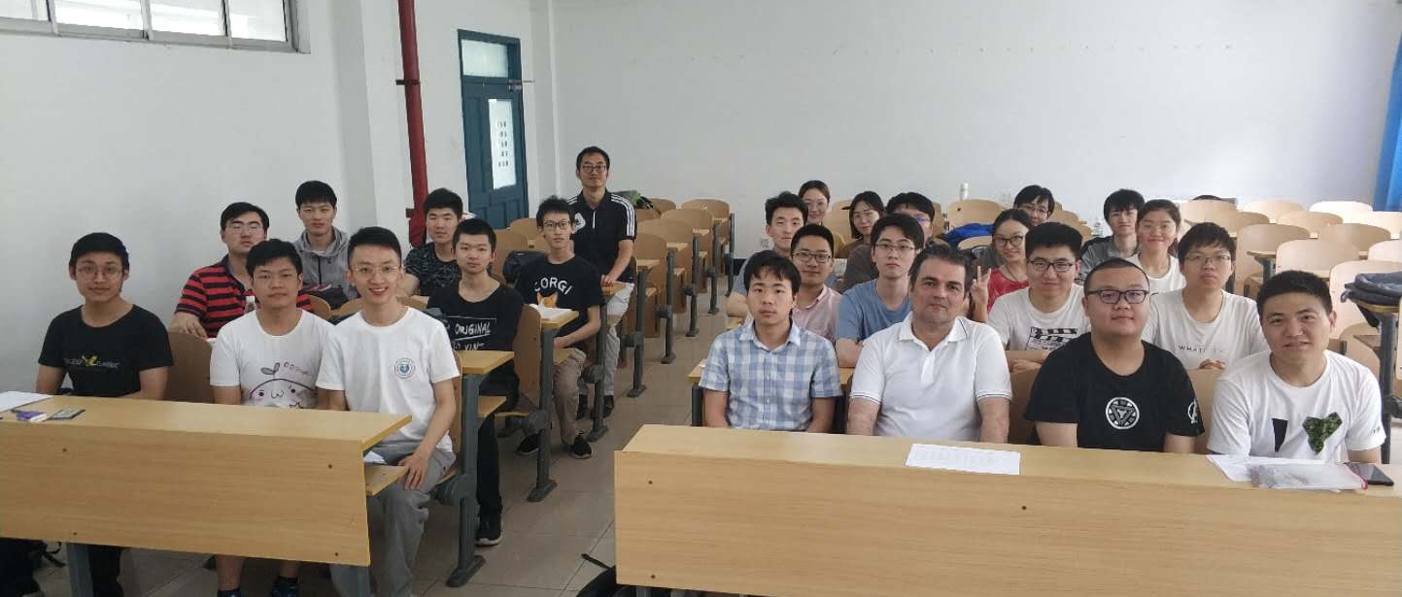
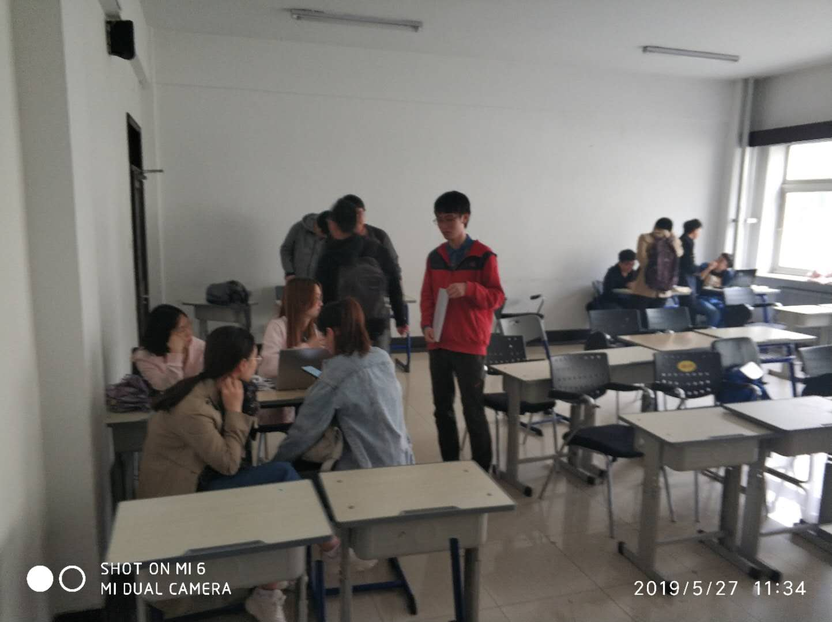
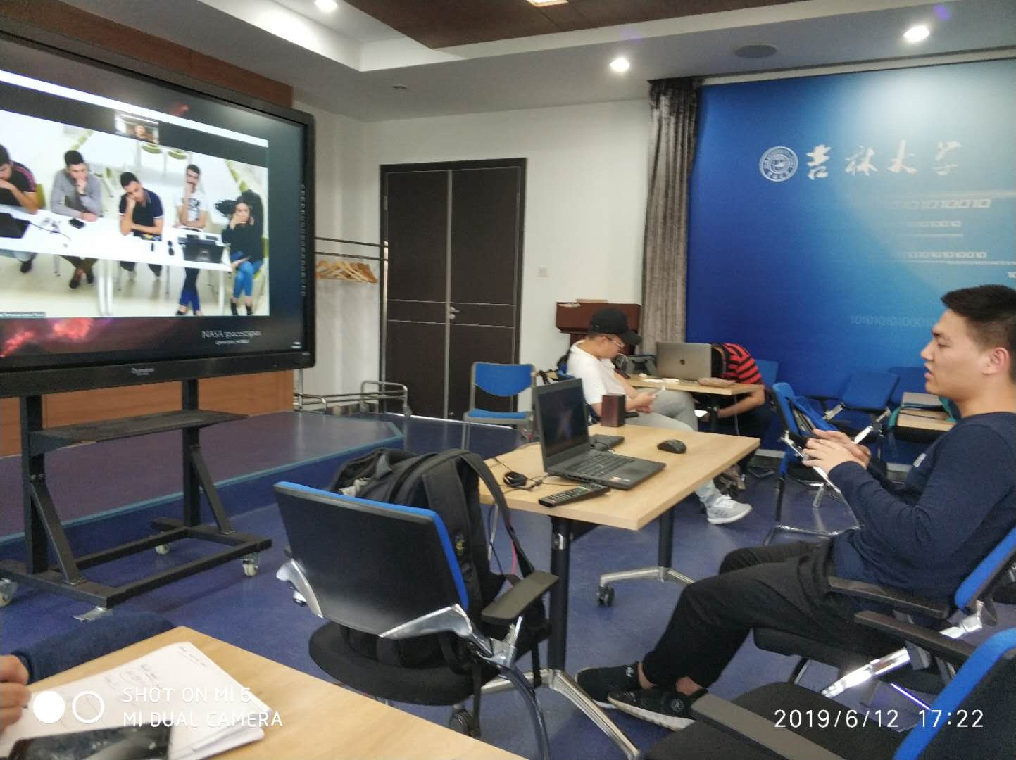
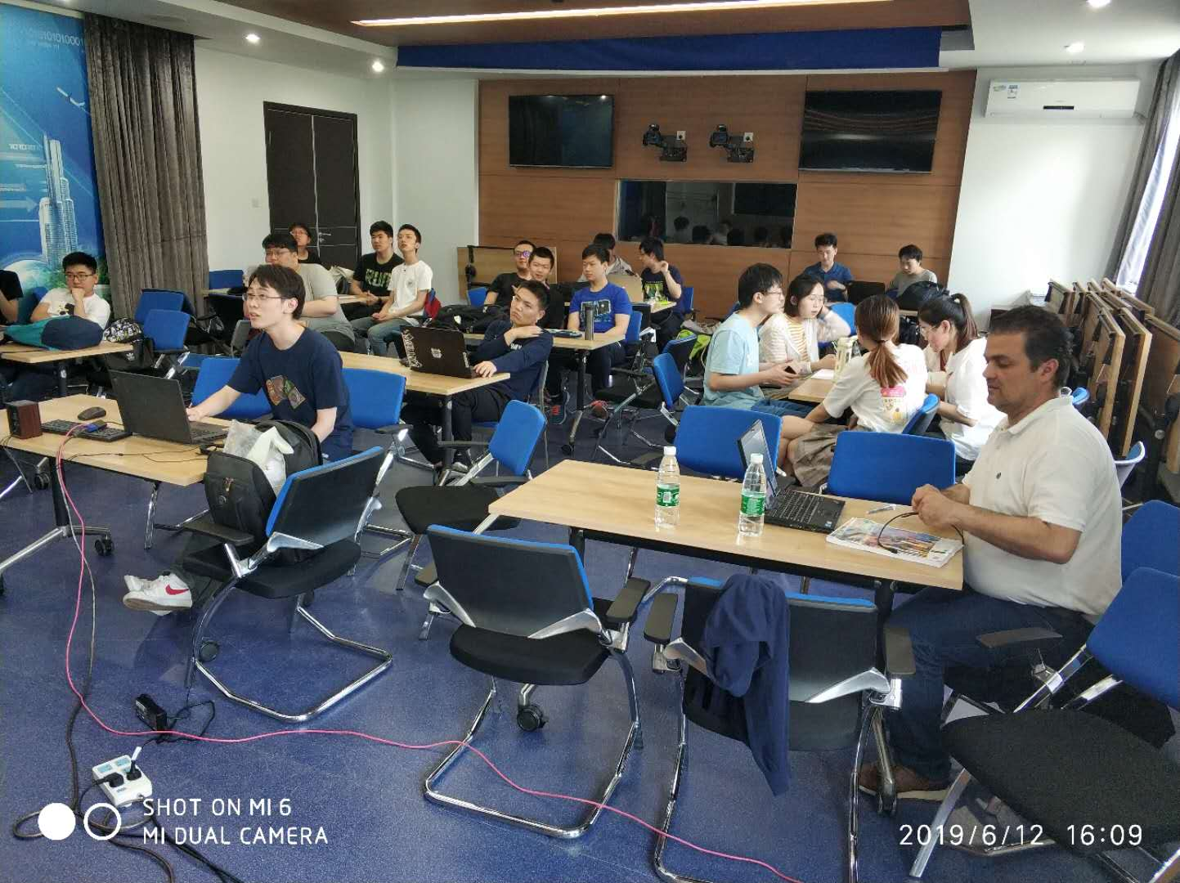
About Previous DSD in JLU

Slide 13
Grades in Spring

Slide 14
Poll
2 answer(s) at most
What do you expect from this course?
A
Pass
B
Experience in Practical SE Project
C
Experience in International Communication
D
Nothing Special
E
Other Expectation to Be Specified
Submit

Slide 15
Fill the blank(s)
Points: 1
What do you expect else from the previous slide?
[Blank 1]
No answer，press the setting on the right side
Spot Dictation is only supported on Version 3.0 or newer.
Answer

Slide 16
Basics
Repository
Prerequisite (Preference)
Channel
Calendar

Slide 17
Before everything: DSD is about the freedom of conscience
良心活儿！

Slide 18
Repository: GitHub
What
GitHub Pages is a static site hosting service designed to host your personal, organization, or project pages directly from a GitHub repository. Example…
Features
Https, no sensitive transactions, GitHub Terms of Service;
Limits
Space: 1GB
Bandwidth: 100GB/month, 10 builds/hour
How
git commands
GitHub desktop/git bash/git gui/…
Vim/sublime/notepad/…

Slide 19
Prerequisite (Preference)
Software Engineering Knowledge
Resource Control
Tool (Github.com, WeChat group)
Format (template, deliverable)
Software Architecture
Process (stages of development)
Architecture (module division)
Software Pattern
Spiral
Iteration
UML
Use case, state transition, component, …

Slide 20
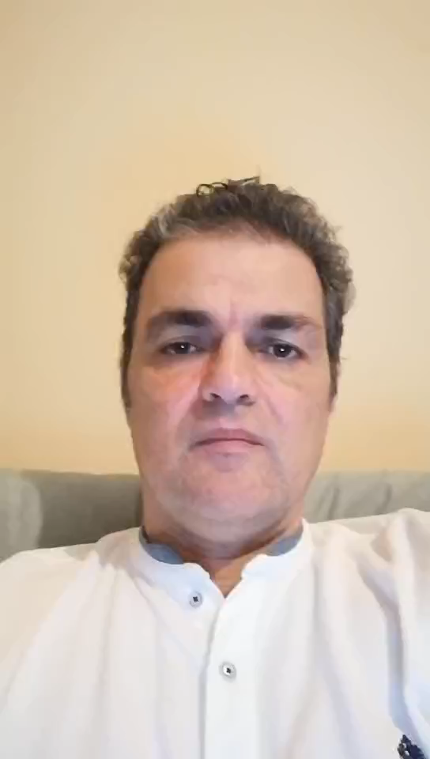
Channel
QQ group (Course administration)
WeChat group (International discussion)
RainClass (slides, assignment, survey)
WeMeet (lecture live broadcasting)
…

Slide 21
Calendar
Holiday
Deadline
All-Sites-Meeting
Sept. 6 | 7 | 8 | 9 | 10 | 11 | 12
13 | 14 | 15 | 16 | 17 | 18 | 19
20 | 21 | 22 | 23 | 24 | 25 | 26
27 | 28 | 29 | 30 | Oct. 1 | 2 | 3
4 | 5 | 6 | 7 | 8 | 9 | 10
11 | 12 | 13 | 14 | 15 | 16 | 17
18 | 19 | 20 | 21 | 22 | 23 | 24
25 | 26 | 27 | 28 | 29 | 30 | 31
Nov. 1 | 2 | 3 | 4 | 5 | 6 | 7
8 | 9 | 10 | 11 | 12 | 13 | 14

Slide 22
Project Description
Project proposals
Extensions

Slide 23
Project Proposals
1. Indoor Positioning via Wi-Fi Finger Print
2. Intelligent Light Control in Classrooms
3. Scoliosis Detection via X-ray Photo Recognition
4. Online Medicine Sales Management System
5. Healthcare Information Integration Platform
…

Slide 24
Management
CV_template
Portuguese Intelligence

Slide 25
Open Question
Points: 2
What kind of roles do you know in a software project team, and what are the corresponding responsibilities?
正常使用主观题需2.0以上版本雨课堂
作答

Slide 26
Team Construction
CV pooling
Role Responsibility
Liaison, to communicate with other teams
PM, to organize discussion and make the final decision
RA, to interact with the customer for clear measurable requirement list and help in design
Arch, to decide the composition of the project from the requirement and create the detailed design, and help in coding
Coder, to implement the design and help in the test and revision
Tester, to judge whether the performance meets the requirements
*Hiring Portuguese Intelligence
Ad.
Website

Slide 27
Homework (Deadline: Friday 23:59)
Team construction
Role distribution
Website construction (ad.)
Private chatting group
Preparation
MOOC on Software Engineering, Software Architecture, Software Project Management…
Project module division based on requirements
Evaluation
Look around…
Form collection

Slide 28
Thanks!

